Slide 1
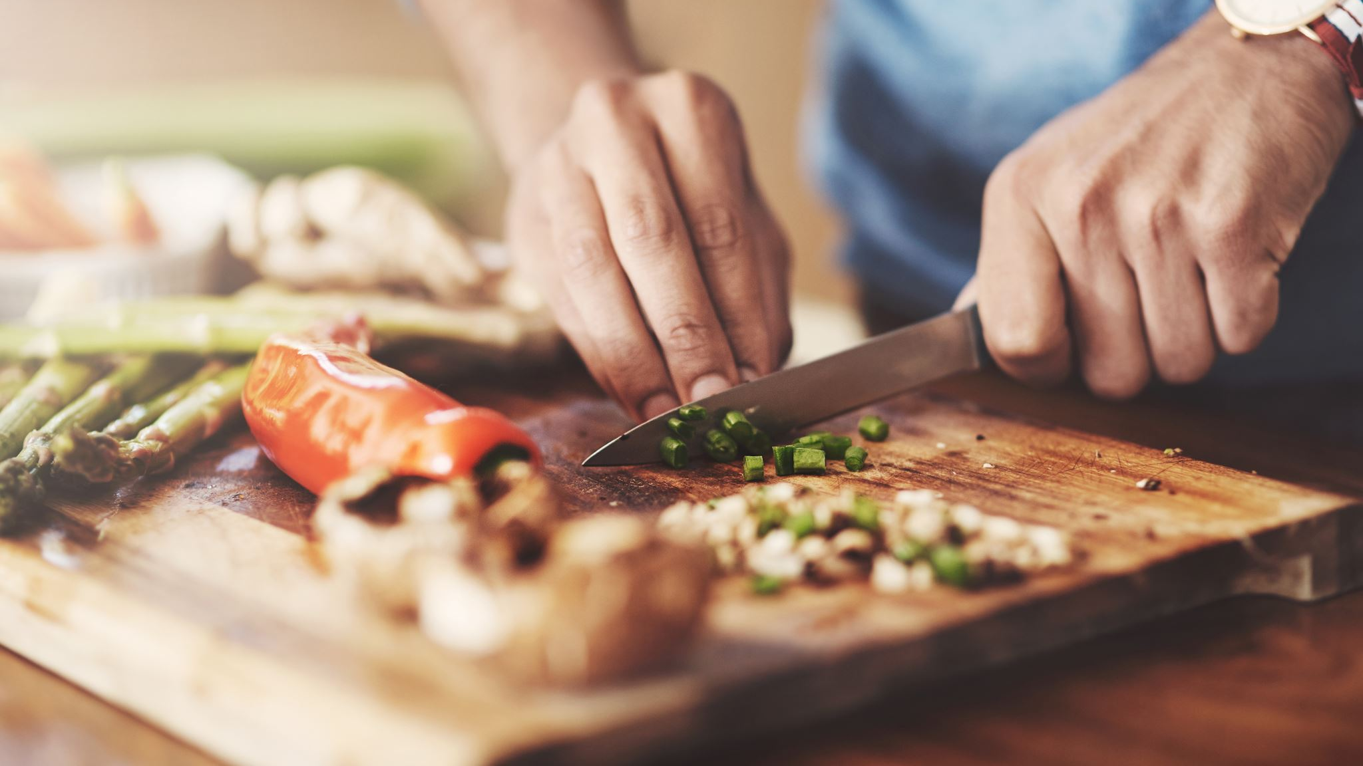
Cooking App
By: Ashwath PadmeGowda, Jeff Santucci, Lisa Whitley, & Steven Woods

Slide 2

Want to cook something new? Have random ingredients left in your fridge?
Come check out our app! We can help you create a new dish with what you have in your fridge!

Slide 3
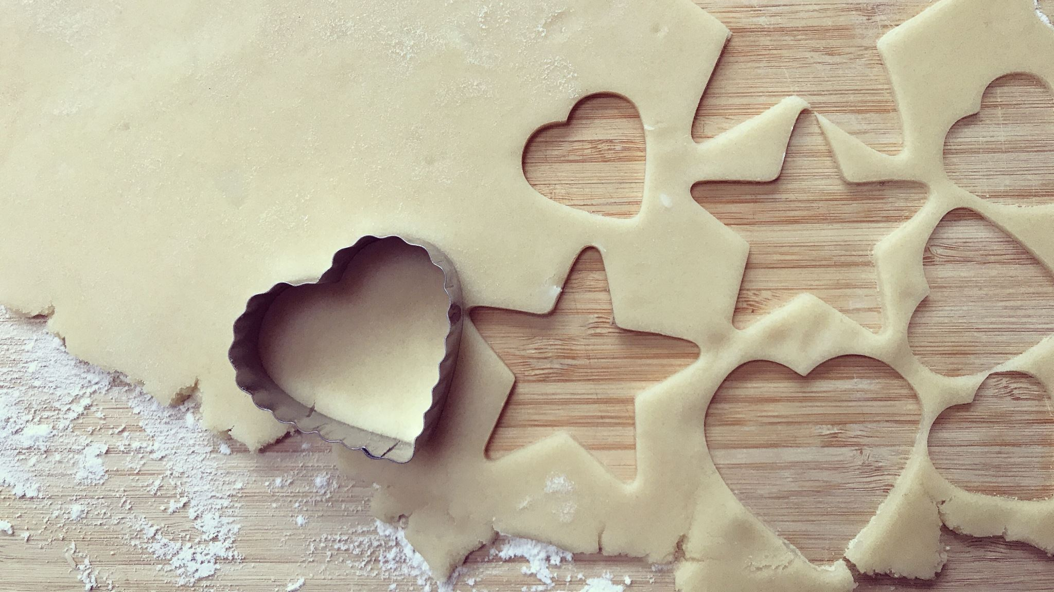
Demo time!
Let’s take a look under the hood!!

Slide 4
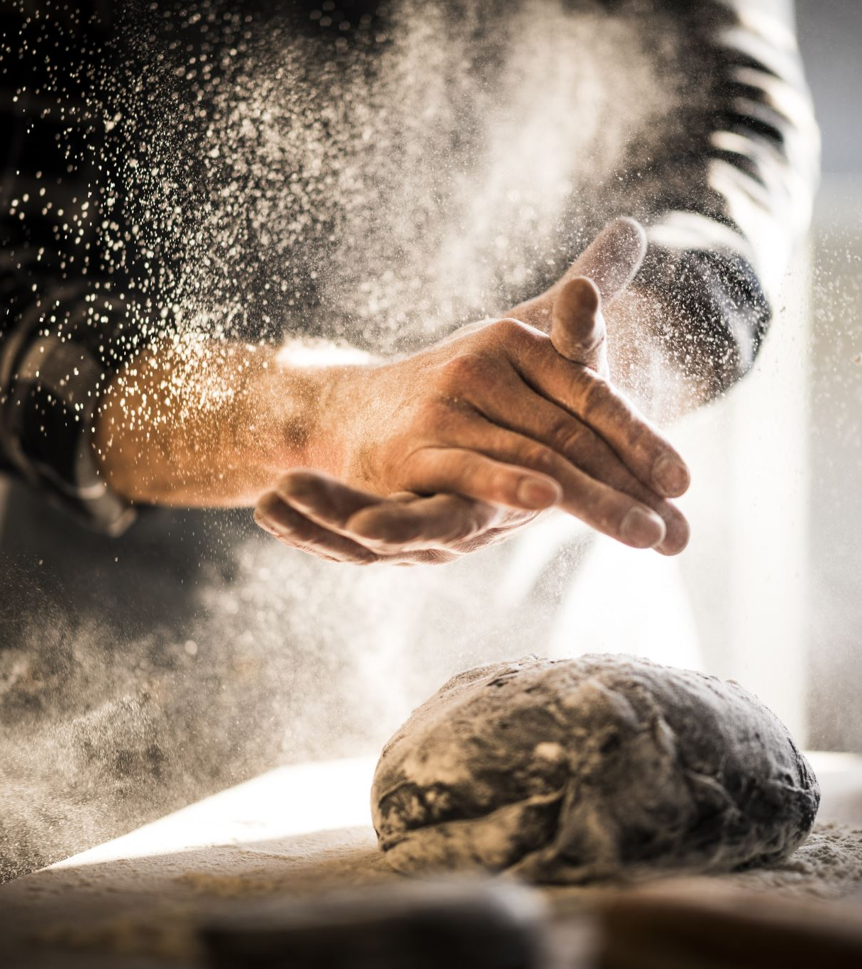
Process
Technologies used: Angular, C#, JavaScript, TypeScript, HTML, CSS, SQL Server, and Azure.
Challenges: The challenges we faced were deploying to Azure, getting the 3rd party API to display on the html page, but we powered through them all.
Successes: We focused on team programming which helped us get through all the hurdles together. We were able to figure out a SQL View, and we were able to get our login pages to work (cookies).
Future developments: In the future we want to be able to allow the user to create or add a recipe and store it in the database too.

Slide 5
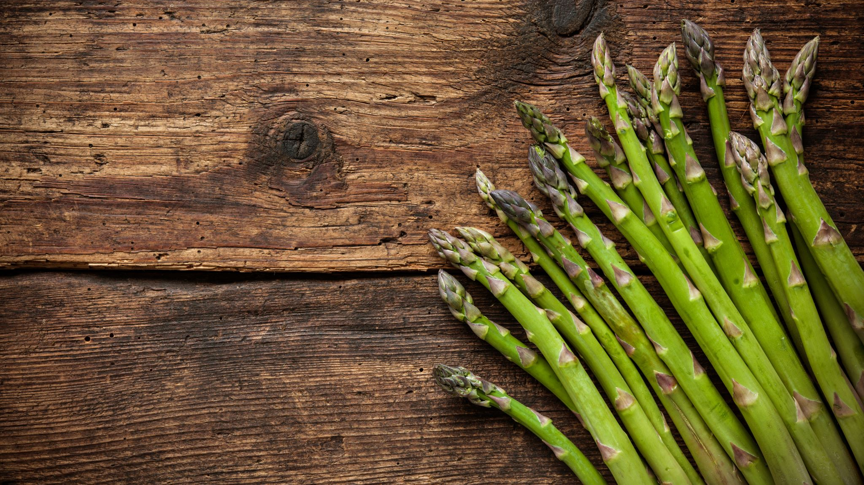
Cooking Links To Project
https://github.com/WhitleyLisa/CookingApp

Slide 6
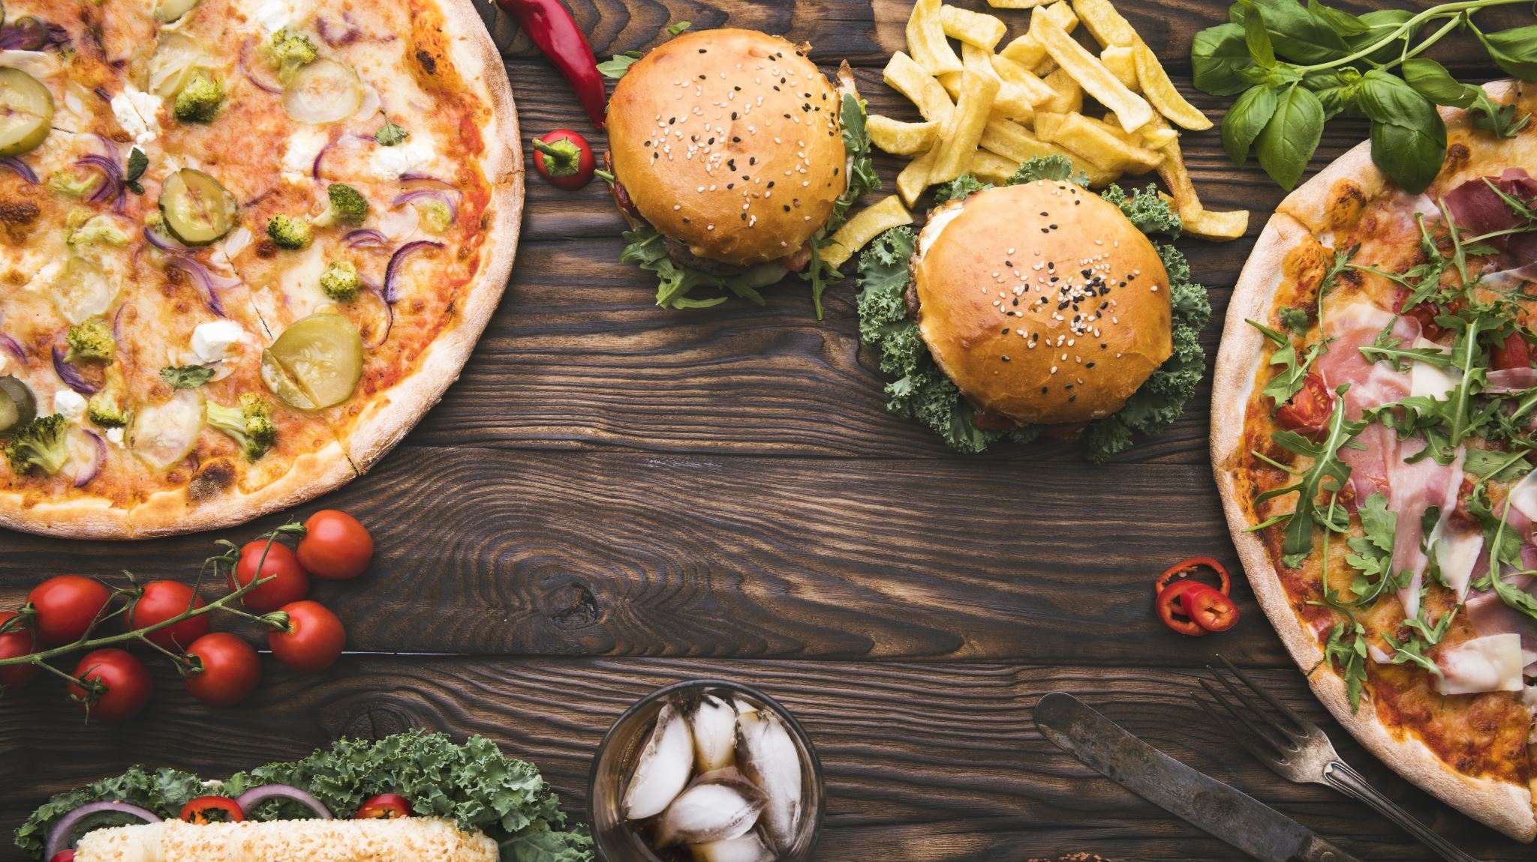
Any Questions?!
We have answers for that!

